Slide 1
Submission Throttling

Slide 2
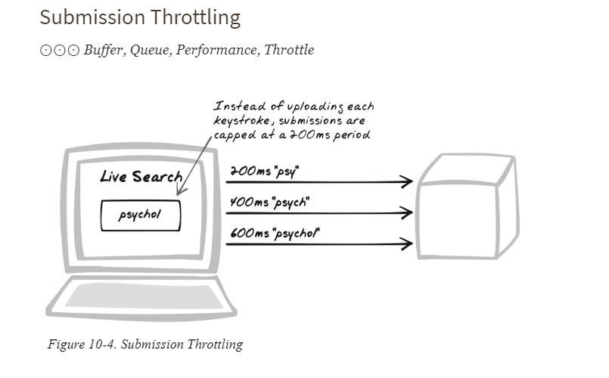

Slide 3
Developer Story
Devi’s producing an Ajax chat web site and wants to transmit text as the user types. However, she knows some users will type faster than the system can cope with so she introduces a throttling mechanism that ensures no more than one message is uploaded every 200 milliseconds.
_{Problem}
How can information be submitted to the server?
Forces
Information is often uploaded in bursts; e.g., a chat tool incurs many hits when a user becomes passionate about the topic, or a data entry tool incurs many hits when the user responds to some new information.
It’s difficult for the server to cope with lots of messages at once.
Browsers can only handle a limited number of pending XMLHttpRequest Calls at any moment.
Each message has overheads, such as packet headers and requires some processing at each stage of the browser/server round-trip.

Slide 4
Solution
Instead of submitting upon each JavaScript event, retain data in a browser-based buffer and automatically upload it at fixed intervals. As with many applications of buffering and throttling, the purpose is to strike a balance between responsiveness and resources. In most cases, it would be ideal to respond to every keystroke and mouse movement—so, for example, like a desktop application, tooltips could come directly from the server as the user mouses around. But that’s not practical due to bandwidth considerations, and possibly server constraints too. So to ease bandwidth—and to lessen server processing, call detail is accumulated and periodically uploaded.

Slide 5
Demo

